Slide 1
CapStore Application

Slide 2
Team Members :
Aishwarya Lakshmi Madhira Sai Deepthi Manasa Gundaji Varun Maddineni

Slide 3
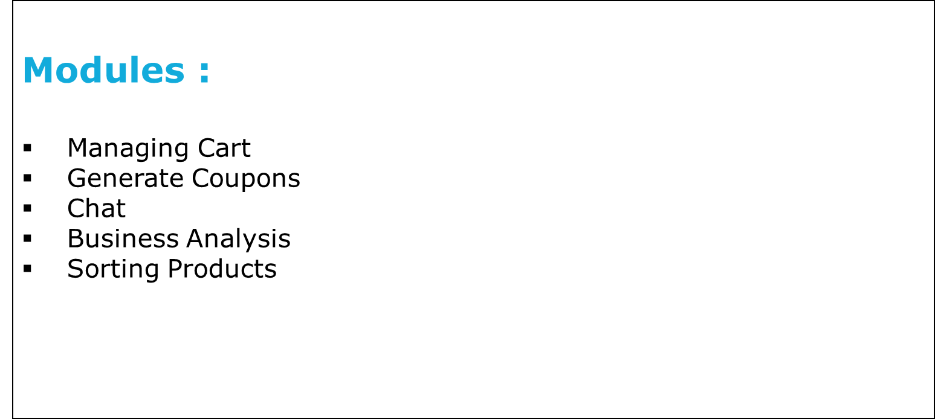

Slide 4
Managing Cart:
Admin should set the minimum cost of purchase.
Customer should be able to add or remove the items from their cart.
Updation of the total amount.
Notes:
Fixar a posicao do titulo – sempre do lado esquerdo.
Sempre que tiver muito texto o coluna deve sempre ser “ narrowed” , se nao fica dificil de ler. Colocar paragrafos no texto.
Linha vertical deve ser mais fina e as pontas NUNCA devem ser arredondadas.

Slide 5
Table 1: Cart
Column_name | Datatype | Constraints | description
Cart_id | int | Primary key
Customer_id | int | Foreign key | Fetch customer details
Inventory_id | Int | Foreign key | Fetch product details
Product_Qty | Int
Price | Int

Slide 6
Generate Coupons:
Generate coupons with unique id.
Setting the expiry date for a particular coupon.
Assigning amount for a coupon.
Description of every coupon.
Notes:
Fixar a posicao do titulo – sempre do lado esquerdo.
Sempre que tiver muito texto o coluna deve sempre ser “ narrowed” , se nao fica dificil de ler. Colocar paragrafos no texto.
Linha vertical deve ser mais fina e as pontas NUNCA devem ser arredondadas.

Slide 7
Table 2: Coupon
Column_name | Datatype | Constraints | description
Coupon_id | int | Primary key | Auto generated
Coupon _code | int |  | Unique alpha numeric code
Description | varchar |  | Explanation about coupon
Coupon_amount | Int
Start_date | date
Expire_date | date

Slide 8
Chat :
3 types of chat boxes will be available, each on customer’s side, merchant’s side and admin’s side.
A customer can interact with a customer representative.
Merchant can interact with the customer representative.
Admin can interact with both merchants as well as customers depending upon their availability. [The availability is decided with the ‘status’ field]

Slide 9
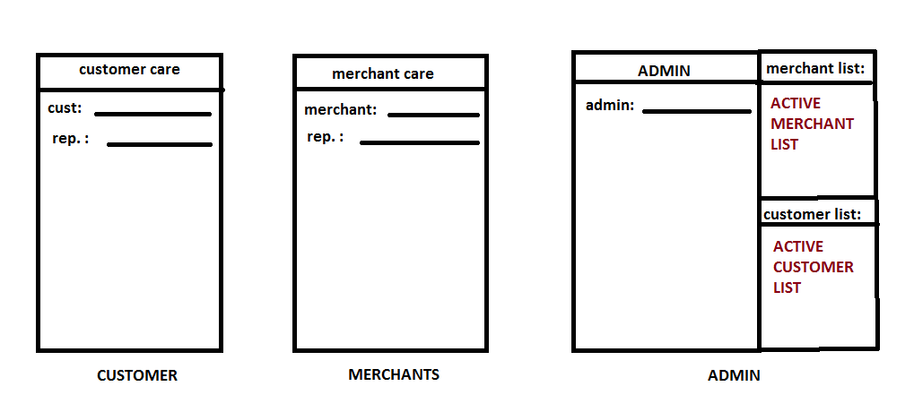
Chat :

Slide 10
Business Analysis :
Generating the analysis statement at the end of day.
Dispatch Report of particular product .
This will be done based on different categories of products, and also for individual products for a particular merchant.

Slide 11
Table 3: Analysis
Column_name | Datatype | Constraints | description
Inventory_id | int | Foreign key | Fetch product id from inventory table
Merchant_id | int | Foreign key | Fetch merchant id from mercahant table
Product_category | varchar
Sales_percentage | double |  | Display the percentage based on sales

Slide 12
Sorting Products :
Displaying the products by sorting it in ascending or descending order of price.
Displaying the products in a given price range.
Able to view most viewed and best seller products.

